Slide 1
JSON Data Modeling
Matthew D. Groves, @mgroves

Slide 2
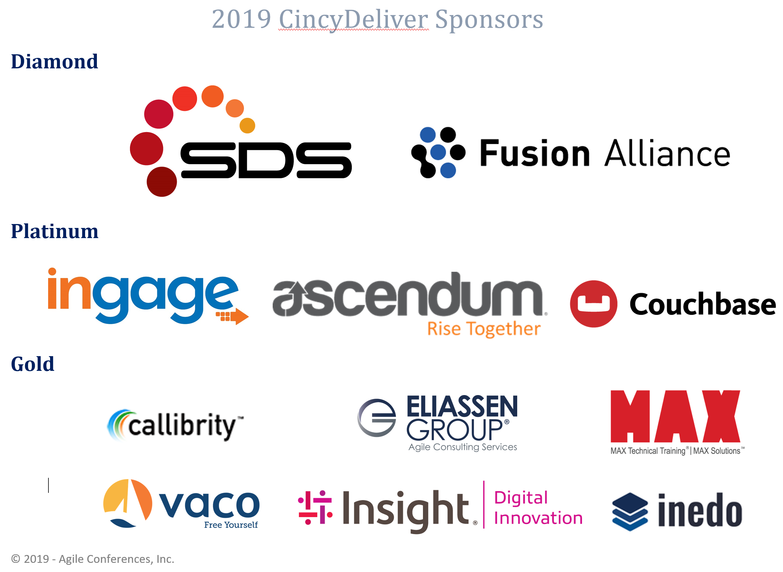
CincyDeliver 2019 Sponsors

Slide 3
Modeling Data in a Relational World
Contacts
Billing
Customer
Purchases
Connections
Notes:
Most developers are probably already familiar with the relational way of modeling data
But if you want the benefits of a non-relational database, you have to think differently about modeling

Slide 4

Where am I?
Cincy Deliver
https://www.cincydeliver.org/

Slide 5

Who am I?
Matthew D. Groves
Developer Advocate for Couchbase
@mgroves on Twitter
Podcast and blog: https://crosscuttingconcerns.com
"I am not an expert, but I am an enthusiast." – Alan Stevens
by @natelovett

Slide 6
JSON Data Modeling
Matthew D. Groves, @mgroves

Slide 7
AGENDA
01/ | Why NoSQL?
02/ | JSON Data Modeling
03/ | Accessing Data
04/ | Migrating Data
05/ | Summary / Q&A
Notes:
Spend just a little time on why people are using NoSQL
Talk about how data is modeled differently in JSON
Let’s talk about why SQL is good and why SQL for JSON is needed
Talk about accessing data, since that has an effect on modeling
Maybe we'll get to migrating/syncing data from relational to nosql

Slide 8
Why NoSQL?
1
Notes:
SQL (relational) databases are great. They give you LOT OF functionality.
Great set of abstractions (tables, columns, data types, constraints, triggers, SQL, ACID TRANSACTIONS, stored procedures and more) at a highly reasonable cost.
Change is inevitable
One thing RDBMS does not handle well is CHANGE.
Change of schema (both logical and physical), change of hardware, change of capacity.
NoSQL databases ESPECIALLY ONES DESIGNED TO BE DISTRIBUTED tend to help solve problems with: agility, scalability, performance, and availability

Slide 9
NoSQL Landscape
Document
Couchbase
MongoDB
DynamoDB
CosmosDB
Key-Value
Couchbase
Riak
BerkeleyDB
Redis
Graph
OrientDB
Neo4J
DEX
GraphBase
Wide Column
Hbase
Cassandra
Hypertable
Notes:
Let’s talk about what NoSQL is, first.
NoSQL generally refers to databases which lack SQL or don’t use a relational model
Once the SQL language, transaction became optional, flurry of databases were created using distinct approaches for common use-cases.
KEY-Value simply provided quick access to data for a given KEY.
Wide Column databases can store large number of arbitrary columns in each row
Graph databases store data and relationships as first class concepts
Document databases aggregate data into a hierarchical structure.
With JSON is a means to the end. Document databases provide flexible schema,built-in data types, rich structure, implicit relationships using JSON.

Slide 10
NoSQL Landscape
Document
Couchbase
MongoDB
DynamoDB
CosmosDB
Get by key(s)
Set by key(s)
Replace by key(s)
Delete by key(s)
Map/Reduce
Notes:
When we look at document databases, they originally came with a
Minimal set of APIs and features
But as they continue to mature, we’re seeing more features being added
And generally I’m seeing a convergent trend between SQL and NoSQL
But anyway, this set of minimal features, lacking a SQL language and tables gives us the buzzword “nosql”

Slide 11
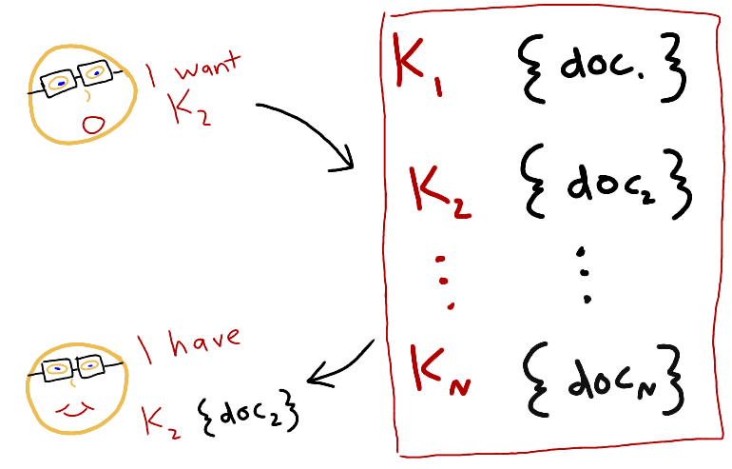
What's NoSQL?
Notes:
Think of a document database at the simplest as a type
of a key/value store, where the value is in a known format
You write code where you start with a key, and you ask the database to return the document
That corresponds to that key.
And the same with creating/updating

Slide 12
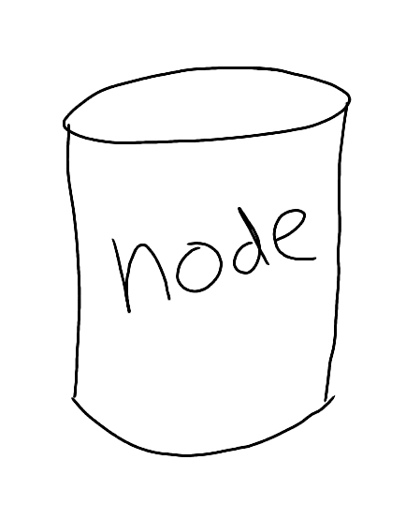
Why NoSQL? Scalability
Notes:
Elastic scaling
Size your cluster for today
Scale out on demand
Cost effective scaling
Commodity hardware
On premise or on cloud
Scale OUT instead of Scale UP
[example: changing the channel to a soccer game or Game of Thrones, everyone makes the same API request in the same 5 minutes]
[example: TV show lets watchers vote during some period of the week, so you can scale up during that period of time]
[example: black Friday]

Slide 13

Why NoSQL? Flexibility
Notes:
Schema flexibility
Easier management of change in the business requirements
Easier management of change in the structure of the data
Sometimes you're pulling together data, integrating from different sources (e.g. ELT) and that flexibility helps
Document database means that you have no rigid schema. You can do whatever the heck you want.
That being said, you SHOULDN’T. You should still have discipline about your data.

Slide 14
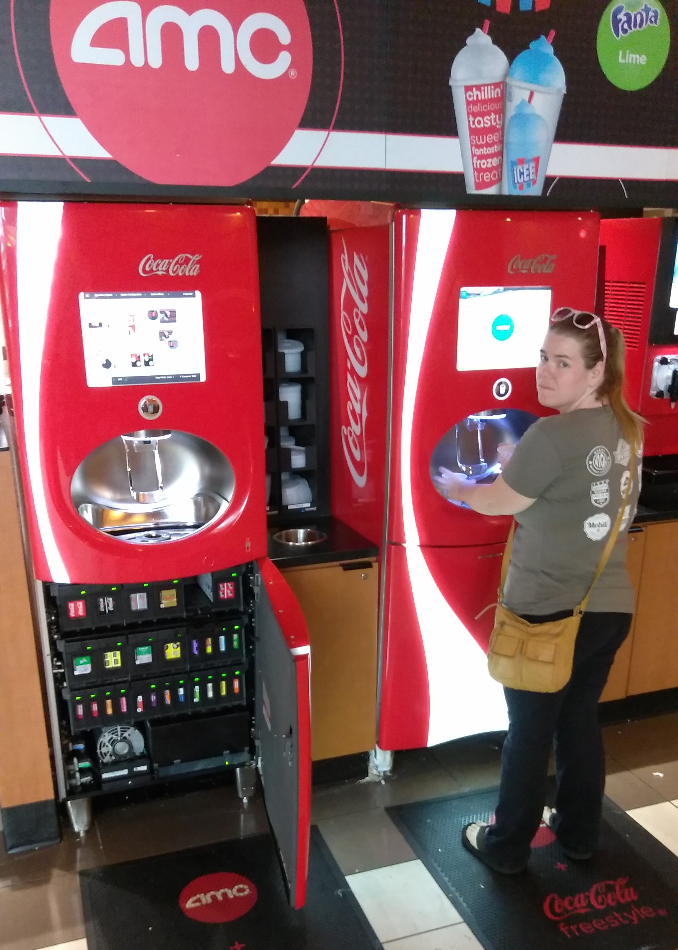
Why NoSQL? Availability
Notes:
If one machine goes down, customers can still use the other.
Or if you need to perform maintenance, upgrade, etc, you don't have to take the whole system down
This is related to scaling
Built-in replication and fail-over
No application downtime when hardware fails
Online maintenance & upgrade
No application downtime

Slide 15

Why NoSQL? Performance
Notes:
NoSQL systems are optimized for specific access patterns
Low response time for web & mobile user experience
Millisecond latency
Consistently high throughput to handle growth
[perf measures can be subjective – talk about architecture, integrated cache, maybe mention MDS too]

Slide 16
Use Cases for NoSQL
Caching
Session
User profile
Catalog
Content management
Personalization
Customer 360
IoT
Communication
Gaming
Advertising
Travel booking
Loyalty programs
Fraud monitoring
Social media
Finance
https://www.couchbase.com/customers
Notes:
NoSQL is very versatile and can be used for a wide variety of use cases
Including, but NOT limited to these
If you're exploring NoSQL, make sure you have the right project or right use case.
Using a NoSQL database does NOT mean you have to abandon relational databases. Most large websites use a combination.
And it's also worth pointing out that plenty of companies are doing (most) of these use cases with relational as well.
Relational usually is at least mediocre, NoSQL may be BETTER
But usually the catalyst is one of the earlier reasons: performance, flexibility, scale.

Slide 17
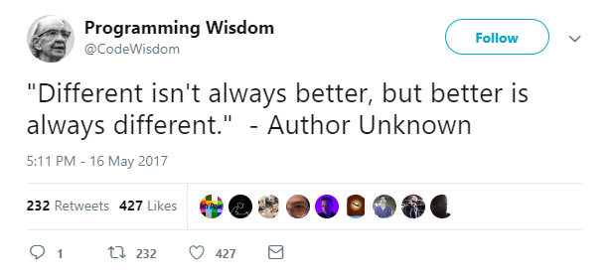
Use Cases

Slide 18
JSON Data Modeling
2
Notes:
Let’s talk about data modeling a bit, because storing data in JSON
Is different that storing in tables.

Slide 19
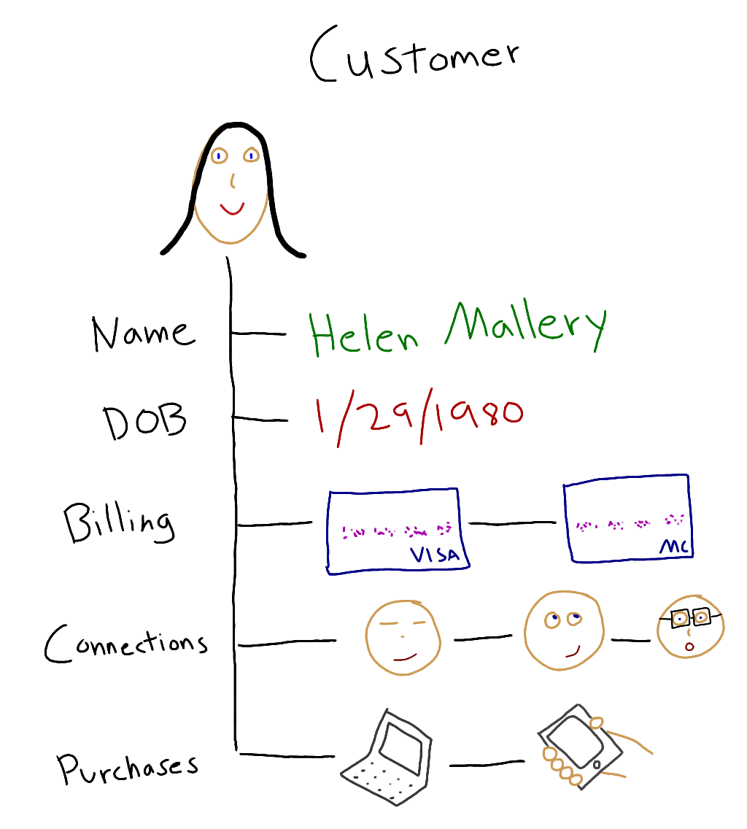
Properties of Real-World Data
Notes:
Let’s look at modeling Customer data. This is an example of what a customer might look like.
You might do this as part of a proof of concept, discovery, requirements gathering, planning, etc
There is a rich structure: attributes, potentially sub-attributes (first name and last name)
Relationships: to other data (other customers, to products perhaps)
Value evolution: Maybe we’d start with one purchase, add more as Helen makes more purchases
Structure evolution: Maybe we start will billing information being properties of Helen, then evolve later to be multiple billing options

Slide 20
Modeling Data in a Relational World
Contacts
Billing
Customer
Purchases
Connections
Notes:
Let’s look at modeling Customer data. This is an example of what a customer might look like
There is a rich structure: attributes, potentially sub-attributes (first name and last name)
Relationships: to other data (other customers, to products perhaps)
Value evolution: Maybe we’d start with one purchase, add more as Helen makes more purchases
Structure evolution: Maybe we start will billing information being properties of Helen, then evolve later to be multiple billing options

Slide 21
Table: Customer
Customer DocumentKey: CBL2015
CustomerID | Name | DOB
CBL2015 | Jane Smith | 1990-01-30
{
"Name" : "Jane Smith",
"DOB" : "1990-01-30”
}
Notes:
Let’s see how to represent customer data in JSON.
The primary (CustomerID) becomes the DocumentKey
Column name-Column value becomes KEY-VALUE pair.

Slide 22
Customer DocumentKey: CBL2015
Table: Customer
{
"Name" : "Jane Smith",
"DOB" : "1990-01-30",
"Purchases" : [
{
"item" : "laptop",
"amount" : 1499.99,
"date" : "2019-03",
}
]
}
CustomerID | Name | DOB
CBL2015 | Jane Smith | 1990-01-30
Table: Purchases
CustomerID | Item | Amount | Date
CBL2015 | laptop | 1499.99 | 2019-03
Notes:
We aren’t normal form anymore
Rich Structure & Relationships
Billing information is stored as a sub-document
There could be more than a single credit card. So, use an array.

Slide 23
Customer DocumentKey: CBL2015
Table: Customer
{
"Name" : "Jane Smith",
"DOB" : "1990-01-30",
"Purchases" : [
{
"item" : "laptop",
"amount" : 1499.99,
"date" : "2019-03",
},
{
"item" : "phone",
"amount" : 99.99,
"date" : "2018-12"
}
]
}
CustomerID | Name | DOB
CBL2015 | Jane Smith | 1990-01-30
Table: Purchases
CustomerID | Item | Amount | Date
CBL2015 | laptop | 1499.99 | 2019-03
CBL2015 | phone | 99.99 | 2018-12
Notes:
Value evolution
Simply add additional array element or update a value.

Slide 24
Customer DocumentKey: CBL2015
Table: Connections
{
"Name" : "Jane Smith",
"DOB" : "1990-01-30",
"Billing" : [
{
"type" : "visa",
"cardnum" : "5827-2842-...",
"expiry" : "2019-03"
}, ...
],
"Connections" : [
{
"ConnId" : "XYZ987",
"Relation" : "Brother"
},
{
"ConnId" : "SKR007",
"Relation" : "Father"
}
}
CustomerID | ConnId | Relation
CBL2015 | XYZ987 | Brother
CBL2015 | SKR007 | Father
Notes:
Structure evolution
Simply add new key-value pairs
No downtime to add new KV pairs
Applications can validate data
Structure evolution over time.
Relations via Reference

Slide 25
DocumentKey: CBL2015
Contacts
{
"Name" : "Jane Smith",
"DOB" : "1990-01-30",
"cardnum" : "5827-2842…",
"expiry" : "2019-03",
"cardType" : "visa",
"Connections" : [
{
"CustId" : "XYZ987",
"Relation" : "Brother"
},
{
"CustId" : "SKR007",
" Relation " : "Father"
}
],
"Purchases" : [
{ "id":12, item: "mac", "amt": 2823.52 }
{ "id":19, item: "ipad2", "amt": 623.52 }
]
}
CustomerID | ConnId | Name
CBL2015 | XYZ987 | Joe Smith
CBL2015 | SKR007 | Sam Smith
Customer
CustomerID | Name | DOB | Cardnum | Expiry | CardType
CBL2015 | Jane Smith | 1990-01-30 | 5827-2842… | 2019-03 | visa
Purchases
Connections
CustomerID | item | amt
CBL2015 | mac | 2823.52
CBL2015 | ipad2 | 623.52
CustomerID | ConnId | Relation
CBL2015 | XYZ987 | Brother
CBL2015 | SKR007 | Father
Notes:
So, finally, you have a JSON document that represents a CUSTOMER.
In a single JSON document, relationship between the data is implicit by use of sub-structures and arrays and arrays of sub-structures.

Slide 26
DocumentKey: CBL2016
Contacts
Billing
{
"Name" : "Bob Jones",
"DOB" : "1980-01-29",
"Billing" : [
{
"type" : "visa",
"cardnum" : "5927-2842-2847-3909",
"expiry" : "2020-03"
},
{
"type" : "master",
"cardnum" : "6273-2842-2847-3909",
"expiry" : "2019-11"
}
],
"Connections" : [
{
"CustId" : "XYZ987",
"Relation" : "Brother"
},
{
"CustId" : "PQR823",
"Relation" : "Father"
}
],
"Purchases" : [
{ "id":12, item: "mac", "amt": 2823.52 }
{ "id":19, item: "ipad2", "amt": 623.52 }
]
}
CustomerID | ConnId | Name
CBL2016 | XYZ987 | Joe Smith
CBL2016 | SKR007 | Sam Smith
CustomerID | Type | Cardnum | Expiry
CBL2016 | visa | 5927… | 2020-03
CBL2016 | master | 6273… | 2019-11
Customer
CustomerID | Name | DOB
CBL2016 | Bob Jones | 1980-01-29
Purchases
Connections
CustomerID | item | amt
CBL2016 | mac | 2823.52
CBL2016 | ipad2 | 623.52
CustomerID | ConnId | Relation
CBL2016 | XYZ987 | Brother
CBL2016 | SKR007 | Father
Notes:
So, finally, you have a JSON document that represents a CUSTOMER.
In a single JSON document, relationship between the data is implicit by use of sub-structures and arrays and arrays of sub-structures.

Slide 27
Modeling your data: Strategies / rules of thumb
{
"Name" : "Jane Smith",
"DOB" : "1990-01-30",
"Purchases" : [
{
"item" : "laptop",
"amount" : 1499.99,
"date" : "2019-03",
},
{
"item" : "phone",
"amount" : 99.99,
"date" : "2018-12"
}
]
}
Relationship is one-to-one or one-to-many
Store related data as nested objects

Slide 28
Modeling your data: Strategies / rules of thumb
Relationship is many-to-one or many-to-many
{
"Name" : "Jane Smith",
"DOB" : "1990-01-30",
"Connections" : [
"XYZ987",
"PQR823",
"PQR828"
]
}
Store related data as separate documents

Slide 29
Modeling tools
Hackolade
Erwin DM NoSQL
Idera ER/Studio
Notes:
Hackolade supports couchbase, mongo, elastic, Cassandra, dynamo
Erwin supports mongodb, couchbase soon?
Idera supports mongodb, couchbase soon?

Slide 30
Accessing Data
3
Notes:
The way you plan to get data out can also affect the way you model your data

Slide 31
Modeling your data: Strategies / rules of thumb
Data reads are mostly parent fields
{
"Name" : "Jane Smith",
"DOB" : "1990-01-30",
"Connections" : [
"XYZ987",
"PQR823",
"PQR828"
]
}
Store children as separate documents

Slide 32
Modeling your data: Strategies / rules of thumb
{
"Name" : "Jane Smith",
"DOB" : "1990-01-30",
"Purchases" : [
{
"item" : "laptop",
"amount" : 1499.99,
"date" : "2019-03",
},
{
"item" : "phone",
"amount" : 99.99,
"date" : "2018-12"
}
]
}
Data reads are mostly parent + child fields
Store children as nested objects

Slide 33
Modeling your data: Strategies / rules of thumb
Data writes are mostly parent or child (not both)
{
"Name" : "Jane Smith",
"DOB" : "1990-01-30",
"Connections" : [
"XYZ987",
"PQR823",
"PQR828"
]
}
Store children as separate documents

Slide 34
Modeling your data: Strategies / rules of thumb
{
"Name" : "Jane Smith",
"DOB" : "1990-01-30",
"Purchases" : [
{
"item" : "laptop",
"amount" : 1499.99,
"date" : "2019-03",
},
{
"item" : "phone",
"amount" : 99.99,
"date" : "2018-12"
}
]
}
Data writes are mostly parent and child (both)
Store children as nested objects

Slide 35
Modeling your data: Strategies / rules of thumb
If … | Then …
Relationship is one-to-one or one-to-many | Store related data as nested objects
Relationship is many-to-one or many-to-many | Store related data as separate documents
Data reads are mostly parent fields | Store children as separate documents
Data reads are mostly parent + child fields | Store children as nested objects
Data writes are mostly parent or child (not both) | Store children as separate documents
Data writes are mostly parent and child (both) | Store children as nested objects
Notes:
What types of relationships are being modeled?
How are the relationships accessed?

Slide 36
Accessing your data (Couchbase)
Key-Value
(CRUD)
N1QL
(SQL Query)
Full Text (Search)
Views
(JS Query)
Analytics
(Query)
Indexes
Indexes
MapReduce
SQL++
Documents
Notes:
I've mostly been talking about key/value access
Most NoSQL databases will have at least one other way to access data besides key/value.
What does this have to do with modeling? Because modeling doesn't exist in a vacuum. You have to think about how you are going to interact with your data.
I'm going to show you some examples from Couchbase.
In Couchbase, we have N1QL, which is ANSI SQL for JSON
I'm also going to briefly cover FTS today. There are other options I'm not going to cover today, including Analytics and Views/MapReduce.

Slide 37
Key/Value
public ShoppingCart GetCartById(string id)
{
return _bucket.Get<ShoppingCart>(id).Value;
}
public void CreateShoppingCart()
{
_bucket.Insert(new Document<ShoppingCart>
{
Id = "shopping-cart-1",
Content = new ShoppingCart { . . . }
});
}
Notes:
Just to reiterate on key/value
If you know the key already, it's really simple and extremely fast to access that piece of data.

Slide 38
Subdocument access
{
"username": "mgroves",
"profile": {
"phoneNumber": "123-456-7890",
"address": {
"street": "123 main st",
"city": "Grove City",
"state": "Ohio"
}
}
}
Notes:
Another thing to consider is whether or not your nosql database
has a "subdocument" API
If they do, then you have even more flexibility
Not all of them do, and some databases may call this something different
But the idea is this: if you only need "address", without a subdocument API
You'd have to pull the entire document over the wire when doing reads/writes
With a subdocument API, you can specify just a specific part to read/write
This can be very helpful is you have large documents, or if you are doing a lot of reads and writes that only need a small portion of the data

Slide 39
Key/Value: Recommendations for keys
Natural Keys
Human Readable
Deterministic
Semantic
Notes:
Since key/value is so fast and easy, it would benefit us to use it as much as possible.
Here are some tips to maximize your key/value usage.

Slide 40
Key/Value: Example keys
author::matt
author::matt::blogs
blog::csharp_8_features
blog::csharp_8_features::comments
Notes:
Starting from "matt" you can walk through this chain of documents
With ONLY key/value access.

Slide 41
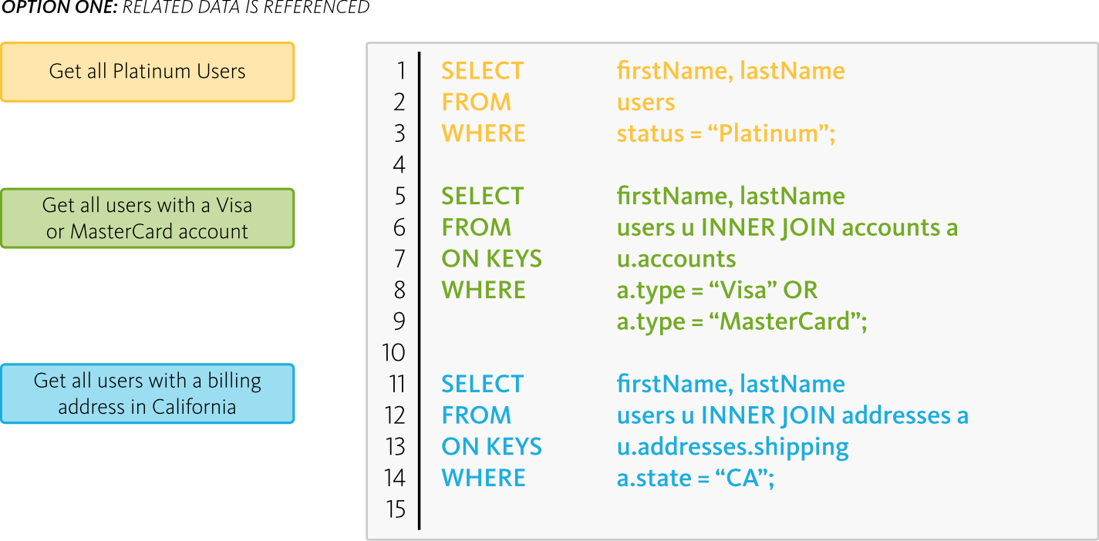
N1QL
Notes:
N1QL is powerful in it's flexibility, declarative nature, familiar to developers, JOINs, etc.
But note, once we step out of key/value access, we need to involve other processes:
We gotta parse the query, most likely use an index service, and in the end we'll get a bunch of keys to lookup the data.
There is overhead involved, but sometimes this is a necessity.

Slide 42
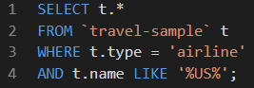
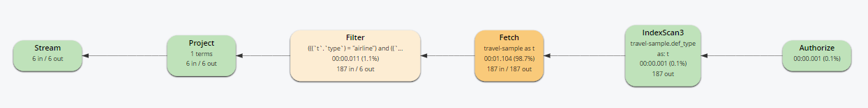
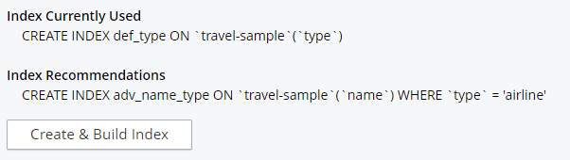
Understanding your Query Plan
Notes:
When you're outside of key/value access, you must understand the query plan.
This is true for ANY database, relational or NoSQL.
As an example, here's a Couchbase SQL query. I execute this and it ran in 1.2 seconds. It's using AN index on the TYPE field, but notice that name field on there.
I can bring up a visualization of the query plan to see which parts are taking up the most time.
Coming soon in Couchbase, we have an index advisor. It suggested an index for me. After creating the index, the same query went to 146ms (about 8 times faster)
Covering index could make this even faster (note the *)

Slide 43
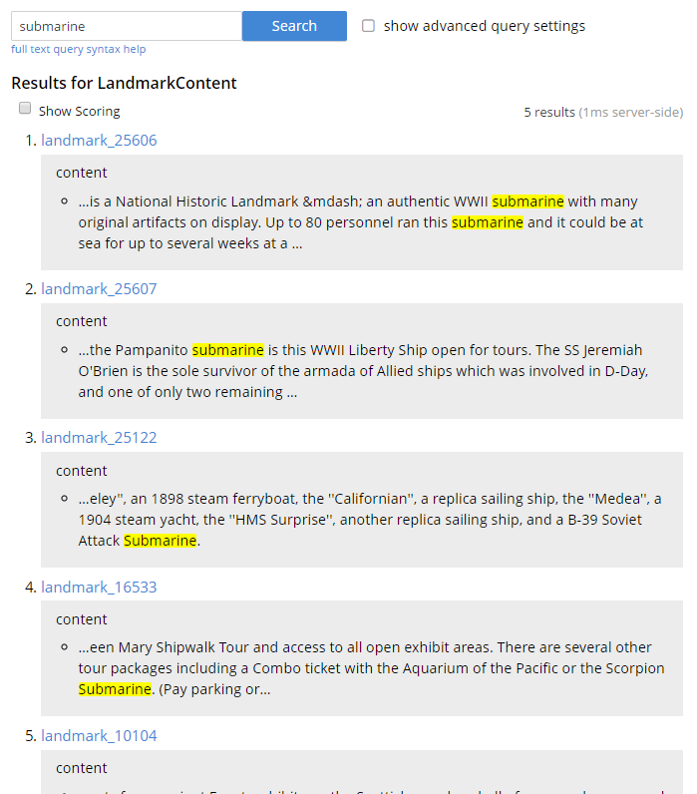
Full Text Search
Notes:
This is a search that revolves around text.
Searching by keyword, facets, geography, price ranges, etc.
This is, again, a very simple example. I'm searching for the keyword "submarine".
In my application, this query may be limited to a certain search radius, or it may be limited to a certain facet, etc.
But the end results are language aware, ranked matches.
You would use this INSTEAD OF a sql 'like' for instance

Slide 44
Accessing your data: Strategies and recommendation
Concept | Strategies & Recommendations
Key-Value Operations provide the best possible performance | Create an effective key naming strategy Create an optimized data model
Full Text Search is well-suited to text | Facets / ranges / geography Language aware
N1QL queries provide the most flexibility – everything else | Query data regardless of how it is modeled Good indexing is vital
Notes:
Build a proof of concept, which will help you see if NoSQL is the right fit
And it will also help you understand the access patterns better
Just to sum up
Also note that in Couchbase, you can combine FTS and N1QL

Slide 45
Migrating Data
4
Notes:
Migrating or syncing
Because often Couchbase and relational are complimentary
Couchbase can be used for engagement, Relational for transactions

Slide 46
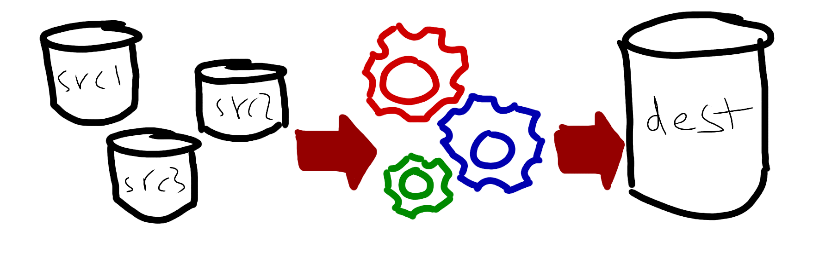
Migration options: Requirements
ETL / data cleanse / data enrichment
Notes:
Are you going to take the time to clean up the data? Do you need to?
Do you need to enrich or restructure the data to take advantage of Json?
Also I'm using the term MIGRATION, but it might NOT be the case that you are abandoning a database in favor of another. You might want to sync data, you might want to make a copy of data into a more suitable database for your use case, etc.

Slide 47




Migration options: Tools
Notes:
informatica, Talend, DART, ODBC, Kafka, Debezium, Spark, Kafka, Nifi

Slide 48


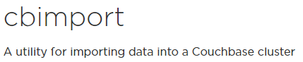



Migration options: BYO
Notes:
Node / Python / bash / Powershell / curl / REST etc
GoldenGate / DTS / SSIS
CLI: cbimport, mongoimport, etc

Slide 49




Migration options: KISS
Relational
Export
Import
Transform
NoSQL
Staging
Notes:
Again, proof of concept
KISS: export to CSV and use N1QL to do any ETL that’s required
Export to CSV
Import as documents into a 'staging' bucket
Use N1QL to transform
Insert into new bucket

Slide 50

Migration Recommendations: Align
Notes:
Align with your data model
The modeling step is vital. If you don't model your data to take advantages of JSON, then you are not going to see the advantages of using JSON. Don't treat a JSON database as if it were a relational database.
Basically keep it as simple as you can and plan for failure. Developers often think of the migration process as “One and Done”, but the reality is that data migration is often an ongoing headache that DevOps needs to monitor and manage in a production environment. Make everyone’s life easier by thinking about the long game as much as possible.

Slide 51

Migration Recommendations: Expect Failure
Notes:
Plan for failure
Bad source data
Hardware failure
Resource limitations (proof of concept vs MVP)
Developers often think of the migration process as “One and Done”, but the reality is that data migration is often an ongoing headache that DevOps needs to monitor and manage in a production environment.

Slide 52

Migration Recommendations: Ensure
Notes:
Ensure: Interruptible, restartable, logged -> predictable
Make everyone’s life easier by thinking about the long game as much as possible.

Slide 53
Sync NoSQL and relational? Automatic Replication
Couchbase
Kafka
RDBMS
DCP
Source
Sink
Stream
Notes:
From NoSQL to relational
You can also turn this around and use Kafka in the other direction

Slide 54
How can you sync NoSQL and relational?
RDBMS
Couchbase
GoldenGate
Handler / Eventing
https://github.com/mahurtado/CouchbaseGoldenGateAdapter
Notes:
From relational to NoSQL:
Goldendate is from oracle
Cdata for SSIS and Couchbase
https://github.com/mahurtado/CouchbaseGoldenGateAdapter
https://www.cdata.com/drivers/couchbase

Slide 55
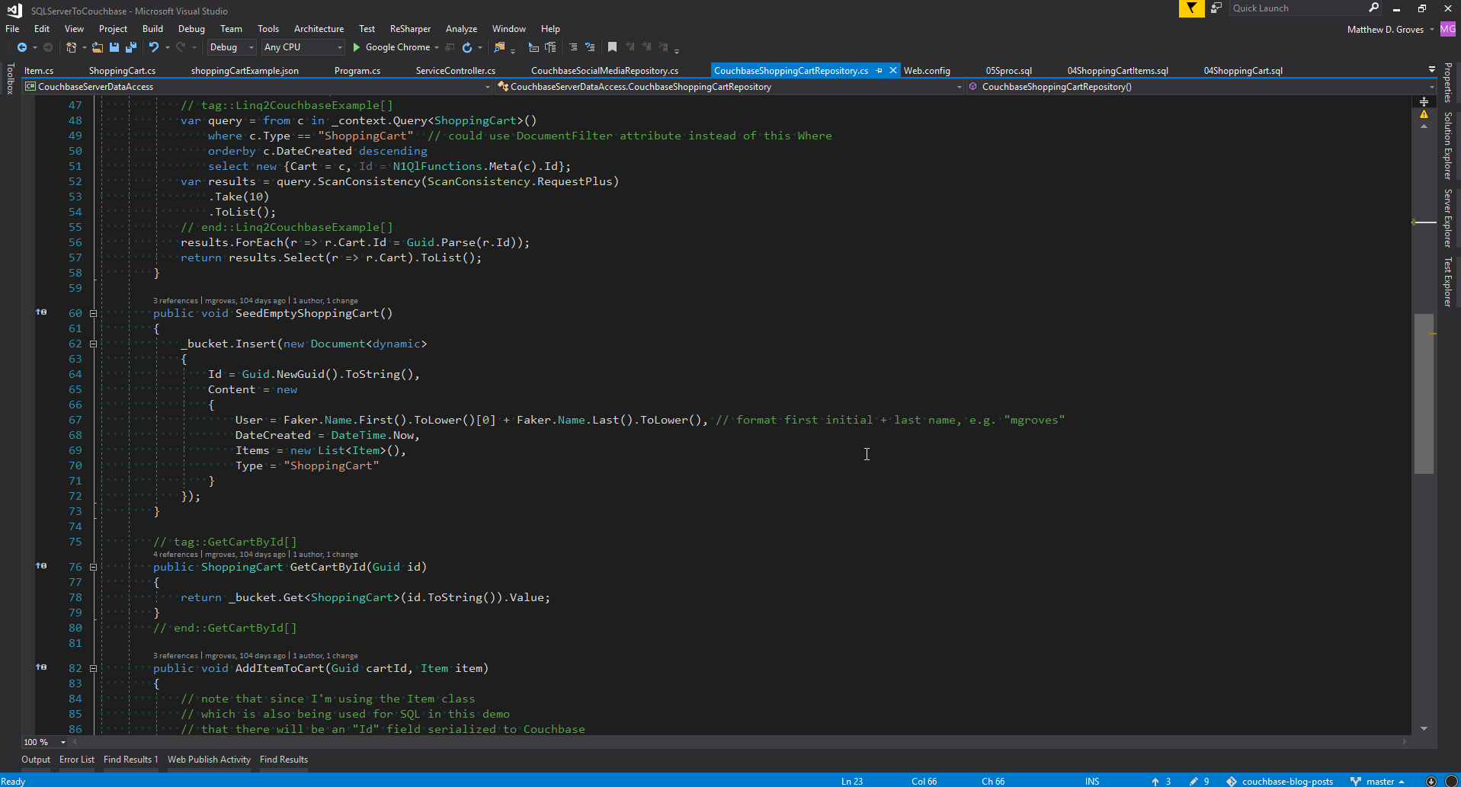
Sync NoSQL and relational? Manual.
Notes:
Make it part of your application directly
May or may not be reusable
This is a lot of work, so make sure you have a good reason

Slide 56
Summary
5

Slide 57
Summary
Pick the right application
Notes:
Focus on SOA, microservices, application/use case specific

Slide 58
Summary
Proof of Concept
Notes:
Modeling, Focus, Success Criteria, Review Architecture
consider using a tool like Hackolade to define models rigorously and collaboratively

Slide 59
Summary
Match the data access method to requirements
Notes:
Use Document type, Versionid
Create optimized, understandable keys
Weigh nested, referenced or mixed designs
Add indexes: Simple, Compound, Functional, Partial, Array, Covering, Memory Optimized
N1QL, Key-value, Views

Slide 60
Resources: Blog posts
https://blog.couchbase.com/proof-of-concept-move-relational/
https://blog.couchbase.com/json-data-modeling-rdbms-users/

Slide 61

Resources: Me!
@mgroves
twitch.tv/matthewdgroves
forums.couchbase.com
Notes:
This is my family
My enormous head barely fits in the picture

Slide 62
Frequently Asked Questions
How is Couchbase different than Mongo?
Is Couchbase the same thing as CouchDb?
How tall are you? Do you play basketball?
What is the Couchbase licensing situation?
Is Couchbase a Managed Cloud Service (DBaaS)?

Slide 63
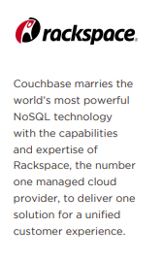

Managed Cloud Server (DBaaS)
< Back
Notes:
Not yet. We've been talking about it at least as long as I've been with Couchbase.
It's partly a technical problem, may need additional features for multi-tenant.
It's partly (mostly) a business problem. Would this be worth it?
Couchbase IS in the Azure and AWS marketplaces, and there are some wizards to make config easy, but it runs on your VMs.
A full DBaaS will be coming soon

Slide 64


MongoDB vs Couchbase
Architecture
Memory first architecture
Master-master architecture
Auto-sharding
Features
SQL (N1QL)
Full Text Search
Analytics (NoETL)
< Back
Notes:
Memory first: integrated cache, you don't need to put redis on top of couchbase
Master-master: easier scaling, better scaling
Auto-sharding: we call vBuckets, you don't have to come up with a sharding scheme, it's done by crc32
N1QL: SQL, mongo has a more limited query language and it's not SQL-like
Full Text Search: Using the bleve search engine, language aware FTS capabilities built in
Mobile & sync: Mongo has nothing like the offline-first and sync capabilities couchbase offers
Mongo DOES have a DbaaS cloud provider

Slide 65
Licensing
Couchbase Server Community
Source code is Open Source (Apache 2)
Binary release is one release behind Enterprise (except major versions)
Free to use in dev/test/qa/prod
Forum support only
Couchbase Server Enterprise
Source code is mostly Open Source (Apache 2)
Some features not available on Community (XDCR TLS, MDS, Rack Zone, etc)
Free to use in dev/test/qa
Need commercial license for prod
Paid support provided
< Back
Notes:
Everything I've shown you today is available in Community edition
The only N1QL feature I can think of not in Community is INFER and Query Plan Visualizer
The Enterprise features you probably don't need unless you are Enterprise developer.

Slide 66




CouchDB and Couchbase
memcached
< Back

